Slide 1
Energy Production
Regression Project (combined-cycle power plant)
Group No – 6
Mentor - Snehal Shinde and K S Siri
Project participants:
- Mr Ritesh Singh
Mr Rama Reddy B T
Ms Sakshi Raju Nimje
Ms Samiksha Suroshe

Slide 2
Introduction:-
In the quest for cleaner and more efficient energy production, combined-cycle power plants have emerged as a leading solution. These plants utilize a sophisticated integration of gas turbines, steam turbines, and heat recovery systems to maximize energy output while minimizing waste. The optimization of these plants is crucial for meeting energy demands sustainably and economically.
The project at hand focuses on modeling the energy generated by a combined-cycle power plant as a function of various operational parameters, including exhaust vacuum and ambient variables. By understanding how these factors impact energy production, the goal is to develop a predictive model that can enhance the plant's performance and efficiency.

Slide 3
Business Problem Statement:-
To improve the combined-cycle power plant's performance by predicting energy production.
Objective:-
A combined-cycle power plant comprises gas turbines, steam turbines, and heat recovery steam generators. In this type of plant, the electricity is generated by gas and steam turbines combined in one cycle. Then, it is transferred from one turbine to another. We have to model the energy generated as a function of exhaust vacuum and ambient variables and use that model to improve the plant's performance.

Slide 4
Understanding Dataset
Data Visualization
Modelling
Feature Engineering
Re-Build Model
Predictions
Data Processing
Project flow:-

Slide 5
Libraries we used:-
Pandas , Numpy
Matplotlib ,Seaborn
StandardScaler
LinearRegression
mean_squared_error, mean_absolute_error, r2_score
SelectKBest
RFE
DecisionTreeRegressor
RandomForestRegressor
GradientBoostingRegressor
KNeighborsRegressor
Rfecv
variance_inflation_factor
ppscore

Slide 6
Data Set Details:-
This is a project where the variable to be predicted is energy production
The data file contains 9568 observations with five variables collected from a combined cycle power plant over six years when the power plant was set to work with a full load.
The variables, or features, are the following:
temperature, in degrees Celsius.
exhaust_vacuum, in cm Hg.
amb_pressure, in millibar. (Ambient pressure)
r_humidity, in percentage. (Relative humidity)
energy_production, in MW, net hourly electrical energy output.

Slide 7
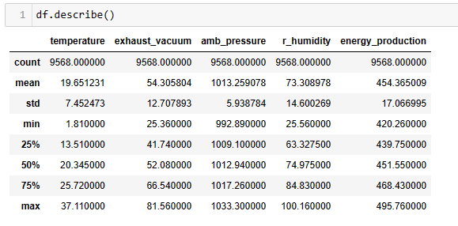
Understanding Dataset:-

Slide 8
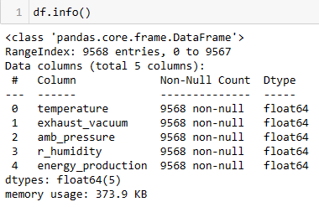

Slide 9
Exploratory Data Analysis

Slide 10
Exploratory Data Analysis (EDA) is the following step after we have cleaned up our dataset. EDA is the process of determining what the data can tell us , and we use it to identify patterns , correlations , and anomalies that will help us with our following analysis . A few methods included in this are :
Pairs plot.
Correlation heat map.

Slide 11
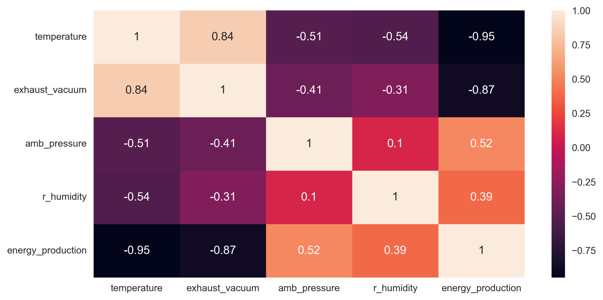
Heat Map
After that we removed duplicate values

Slide 12
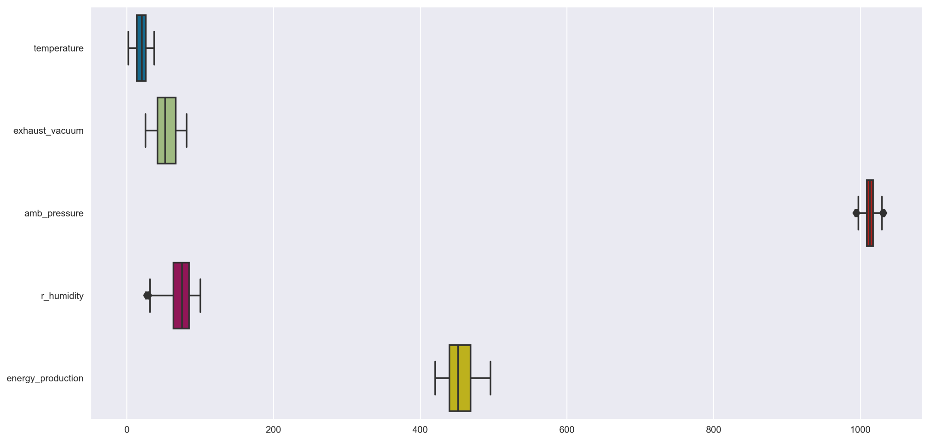
Outlier Detection
In amb_pressure and r_humidity outlires are present.

Slide 13
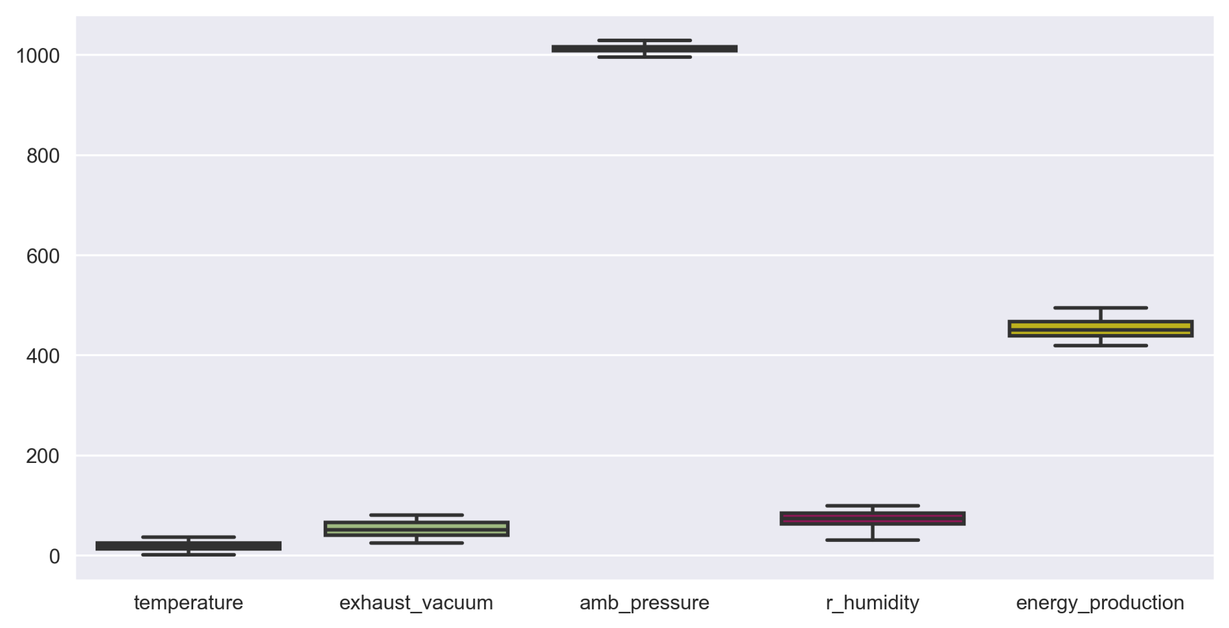
Using the capping process we removed outliers

Slide 14
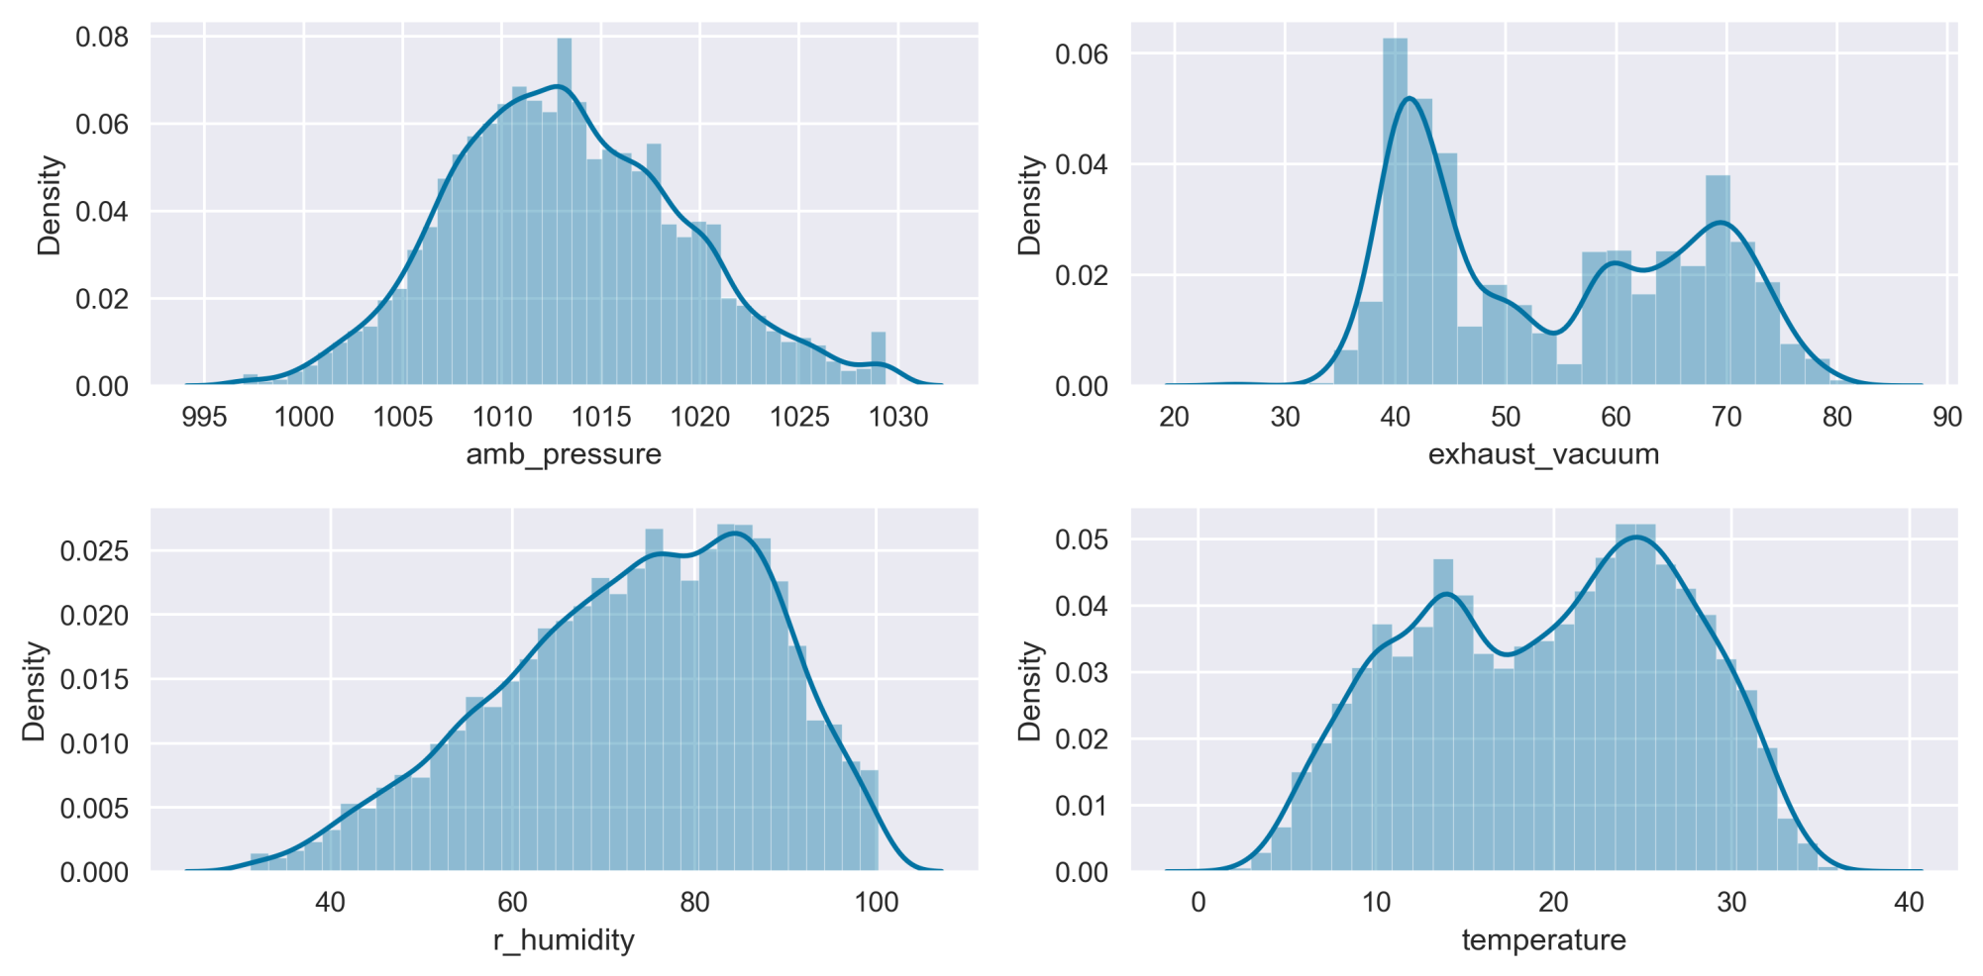
scaling the data
Standardization (Standard Scalar)
Uses z scores for scaling
scale values in such a way that the mean=0 and sd=1

Slide 15
Feature Selection

Slide 16
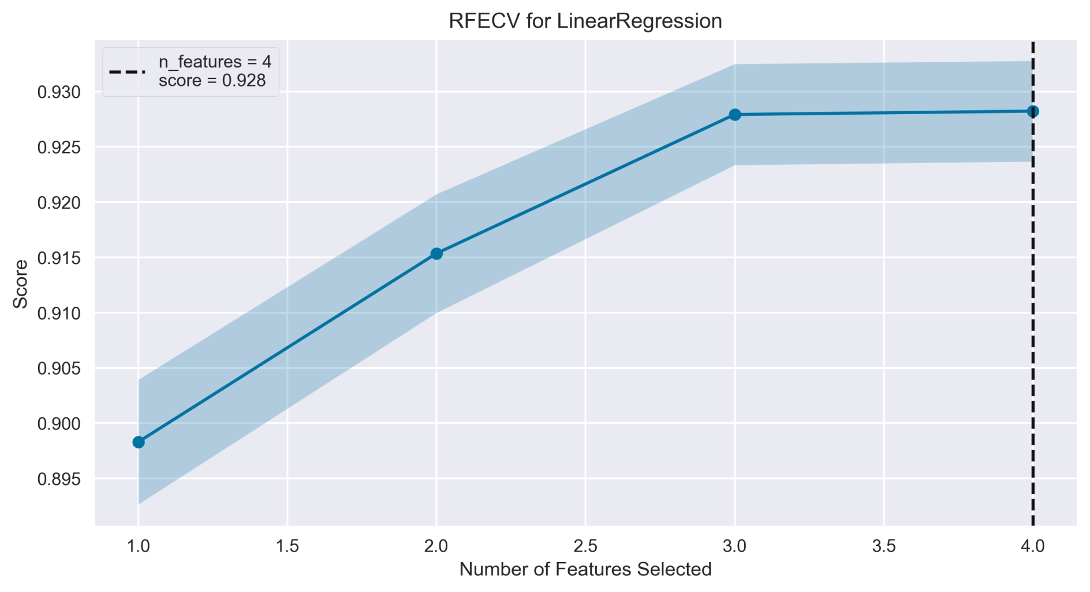
Recursive Feature Elimination: Recursive Feature Elimination (RFE) is a feature
selection algorithm that is used to select a subset of the most relevant features
from a dataset.

Slide 17
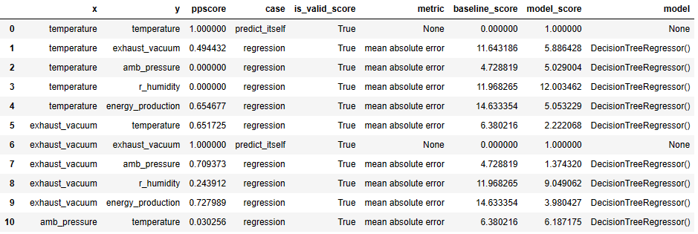
Predictive Power Score: The PPS is an asymmetric, data-type-agnostic score that can detect linear or non-linear relationships between two columns.

Slide 18
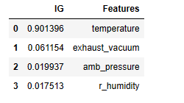
Random Forest Regression: Random forest feature importance

Slide 19
Model Building

Slide 20
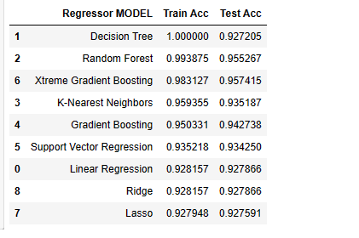
Split data using train_test_split:
Using various Machine Learning model we calculate the train and test Accuracy.

Slide 21
Among all regression models, the Random Forest Repressor model achieves the highest test accuracy of 0.96, making it the top-performing model
Therefore, we select the Random Forest Regressor as final model.

Slide 22
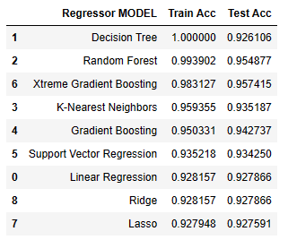
Table for df_capped data:-

Slide 23
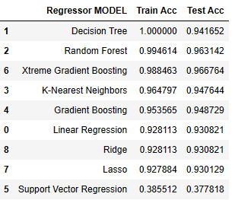
Table for raw data:-

Slide 24
Model Evaluation

Slide 25
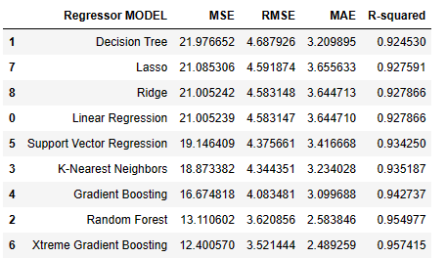
Here among all the modeles xtreme gradient boosting gives least error and r2 accuracy 96%. so our final model is xtreme gradient boosting.

Slide 26
Deployment

Slide 27
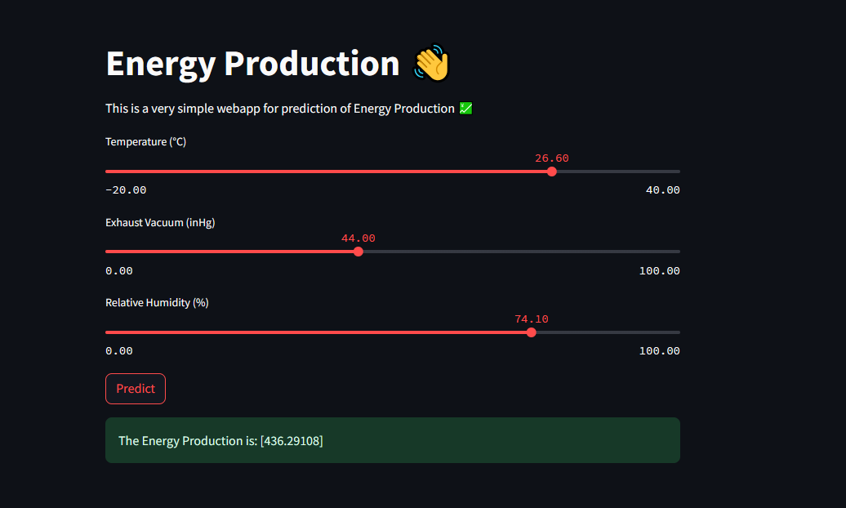
Using pickle5 we saved our model in application.py file and we run our model using streamlit framework.

Slide 28
Thank you

